Slide 1



Kotlin Classes

Slide 2
Class
class ClassName { // build the class }
Kotlin is considered in the following PL Paradigms:
1- Functional Programming (functions, and lambdas)
2- Objected Oriented Programming (classes)
OOP – Like real world objectes (dogs, cat, animal, cars) – objects of a class share:
1-States (attributes)
2-Behavior (methods)
class Thing{/*class body*/}
The class header and body are optional:
class Nothing
State of class:
class Car{
var brand:String=“”;
Var model:String=“”;
Var year:Int =0
}

Slide 3
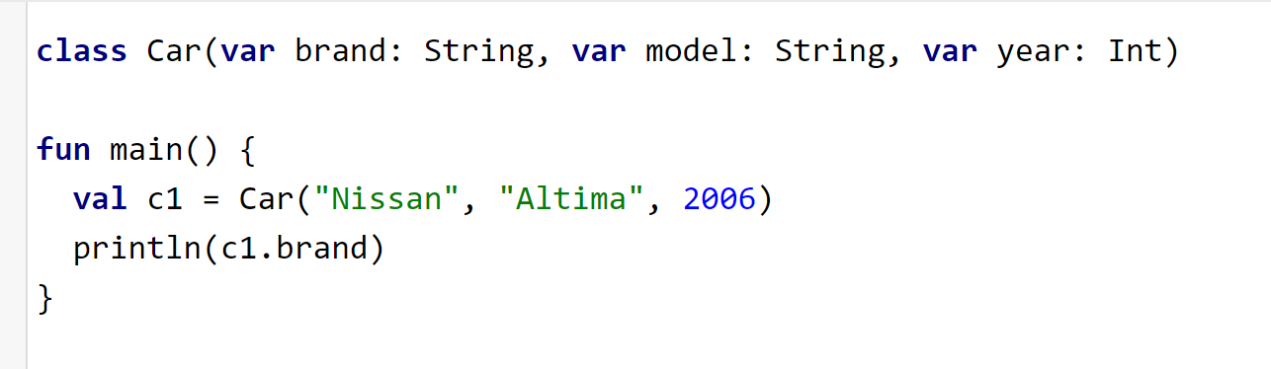
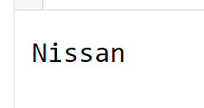
Class
Class Nothing has no body nor header, the class car in the previous slide has no parameter list, the following example with header but no body:

Slide 4




Objects
class Car{
var brand:String=“”;
Var model:String=“”;
Var year:Int =0
}
fun main() {
val c3 = Car()
c3.brand = “Chevy"
c3.model = “Impala"
c3.year = 2011
}
fun main() {
val c0 = Car()
c0.brand = “Kia"
c0.model = “Sevia"
c0.year = 1997
}
fun main() {
val c1 = Car()
c1.brand = "Ford"
c1.model = "Tempo"
c1.year = 1994
}
fun main() {
val c2 = Car()
c2.brand = “Renault"
c2.model = “Clio"
c2.year = 2006
}

Slide 5
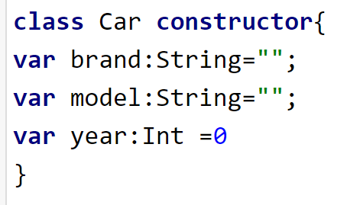
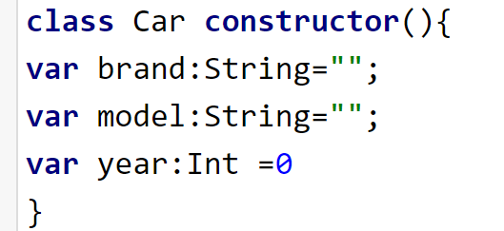
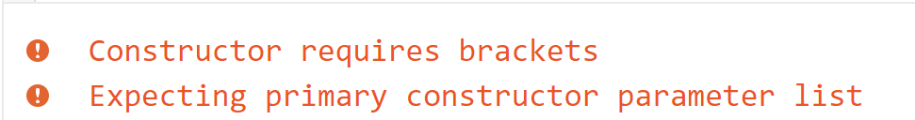
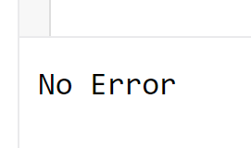
Constructors
class Car constructor(brand: String, model: String, year: Int) { /*.*/ }
The class can have a primary constructor and many secondary to follow.
The primary constructor is part of the header of the class.
The keyword constructor is optional in the class header.

Slide 6
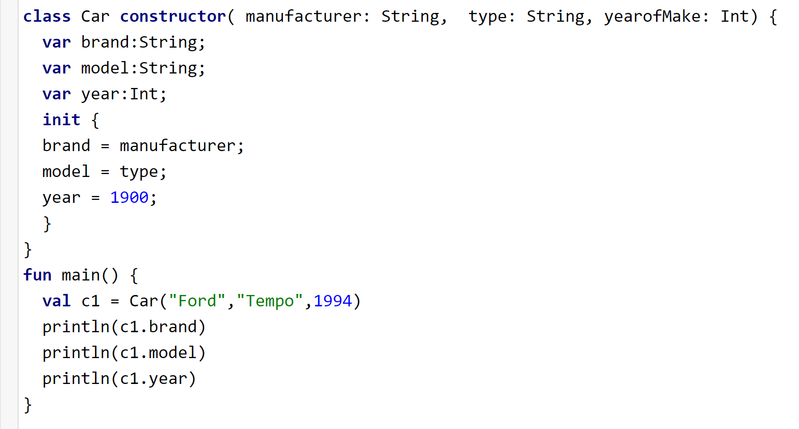
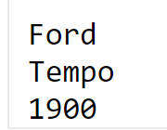
Primary constructor
Primary constructor cannot contain any code, however, you can use the block init to revise the values of the states ( attributes)
States
List of parameters
You can ignore the word constructor
Using the parameters to change the states

Slide 7
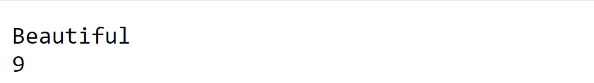
Primary constructor
init blockcan be used to set the attributes with different values
class word (word: String) {
var cWord:String="";
var length:Int=0;
init {
cWord = word.capitalize();
length = word.length;
}
}
fun main() {
val w1 = word("beautiful")
println(w1.cWord)
println(w1.length)
}
Try it here:
https://developer.android.com/training/kotlinplayground

Slide 8
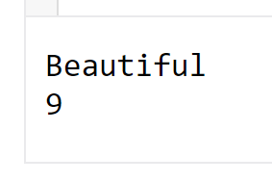
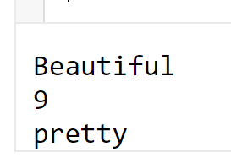
Secondary constructor
//calling secondary instructor
fun main() {
val w2 = word("beautiful")
println(w1.cWord)
println(w1.length)
println(w1.meaning)
}
class word (word: String) {
var cWord:String="";
var length:Int=0;
var meaning:String ="";
init {
cWord = word.capitalize();
length = word.length;
}
constructor(word:String,synonym:String): this(word) {
meaning = synonym; // the primary will take care of cWord and length
}
}
Calling the primary constructor is a must for any secondary
//calling secondary instructor
fun main() {
val w2 = word("beautiful","pretty")
println(w2.cWord)
println(w2.length)
println(w2.meaning)
}

Slide 9
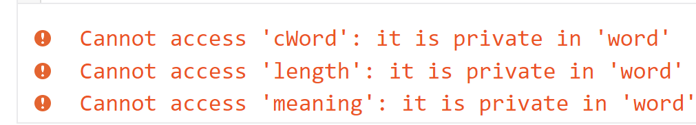
Private members(state or behavior)
//calling private member directly
fun main() {
val w1 = word("beautiful")
println(w1.cWord)
println(w1.length)
println(w1.meaning)
}
class word (word: String) {
private var cWord:String="";
private var length:Int=0;
private var meaning:String ="";
init {
cWord = word.capitalize();
length = word.length;
}
constructor(word:String,synonym:String): this(word) {
meaning = synonym; // the primary will take care of cWord and length
}
}
Defining the states as private

Slide 10
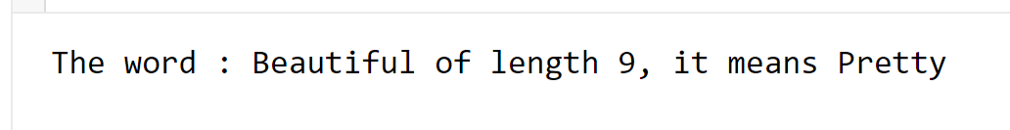
Public members(state or behavior)
//access private states from public behavior
fun main() {
val w1 = word("beautiful","Pretty")
w1.printStates();
}
class word (word: String) {
private var cWord:String="";
private var length:Int=0;
private var meaning:String ="";
init {
cWord = word.capitalize();
length = word.length;
}
constructor(word:String,synonym:String): this(word) {
meaning = synonym; // the primary will take care of cWord and length
}
public fun printStates(){
println(" The word is " + this.cWord+" of length "+this.length + " , it means " +this.meaning);
}
}

Slide 11
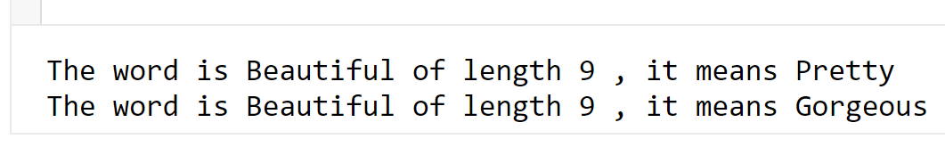
More behaviors
fun main() {
val w1 = word("beautiful","Pretty")
//print before resetting the meaning
w1.printStates();
w1.setMeaning("Gorgeous")
//print after resetting the meaning
w1.printStates();
}
class word (word: String) {
private var cWord:String="";
private var length:Int=0;
private var meaning:String ="";
init {
cWord = word.capitalize();
length = word.length;
}
constructor(word:String,synonym:String): this(word) {
meaning = synonym; // the primary will take care of cWord and length
}
public fun printStates(){
println(" The word is " + this.cWord+" of length "+this.length + " , it means " +this.meaning);
}
public fun setMeaning(_meaning: String){
meaning=_meaning;
}
}

Slide 12
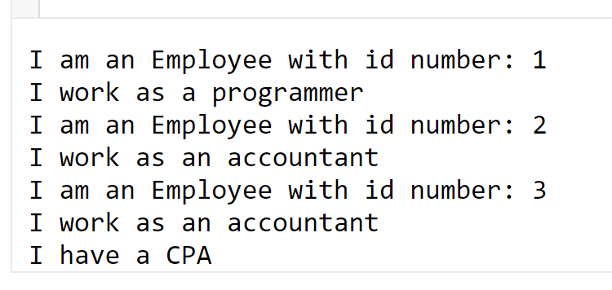
Inheritance
fun main(){
val programmer = Programmer(1)
val accountant = Accountant(2,false)
val cpa_accountant = Accountant(3,true);
}
open class Employee(id: Int){ //base class
init {
println("I am an Employee with id number: $id")
}
}
class Programmer(id: Int) : Employee(id){ //derived-class
init{
println("I work as a programmer")
}
}
class Accountant(id: Int, cpa: Boolean) : Employee(id){//derived-class
init{
println("I work as an accountant")
if(cpa)
println("I have a CPA")
}
}
Base class primary constructor must be called in the derived-class header

Slide 13
References
W3schools.com
https://kotlinlang.org/docs/classes.html
https://docs.oracle.com/javase/tutorial/java/concepts/object.html

